Slide 1
Integrating online tools such as…

Slide 2
PD BACK CHANNEL
FOLLOW THIS LINK:
PD back channel http://goo.gl/tfmvrR .
Prizes are up for grabs again for appropriate/ interesting/helpful/informative comments.

Slide 3
WHY SHOULD I INTEGRATE TECHNOLOGY IN MY TEACHING?
There is a wide availability of new and emerging technology tools that can assist teacher in making teaching much easier and much more fun.
Technology integration in education requires students to actively use technology, not just view technology-based content created by their teachers. The goal of technology integration is for teachers to apply the use of technology in a seamless manner so that it supports and extends curriculum objectives and engages students in meaningful learning.

Slide 4
Agenda:
Edmodo and Blendspace
Edmodo and Google Docs
Edmodo and Weebly
Examples of integrated lessons
Create your own integrated lesson.

Slide 5
What do I already know?
After a few PD sessions you may now have a range of skills and tools to integrate into your lessons.
You have an Edmodo account
You have a Blendspace account
You have a Google Docs account
You have a Weebly site
Do you feel a little overwhelmed?
Isn’t it a pain having numerous windows open or having to login to different accounts?
How can you use each of these tools in an integrated way to effectively engage your students?
How can you centralise these tools to avoid sending students to numerous online locations?

Slide 7
&
Did you know that you can add a blendspace app to your Edmodo account?
By adding this app you will be able to easily share your Blendspace lessons with your students. You can do this easily without having to log in

Slide 14
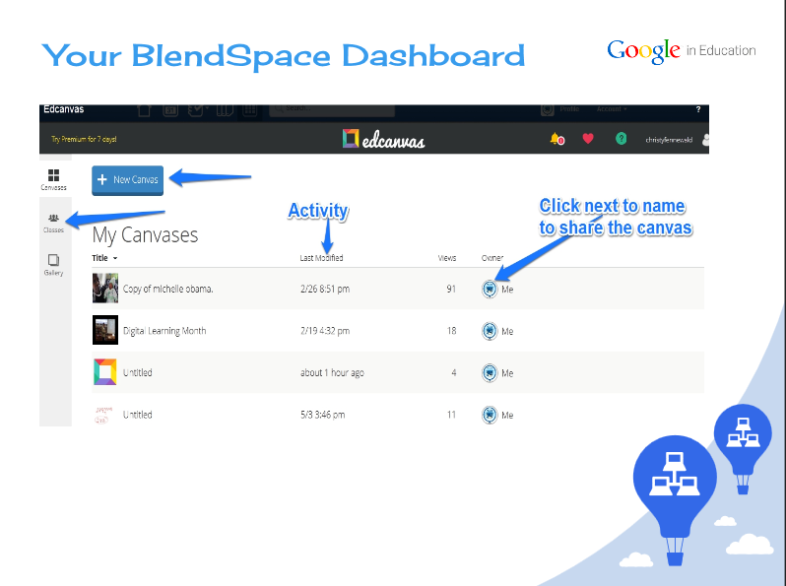

Slide 17
&
Did you know that you can synchronise your Google Docs to your Edmodo library?
By synchronising your documents you will be able to easily share your Google Documents with your students. You can do this easily without having to log into your account.
Students will also be able to TURN IN their own Google Docs as assignments once they have synchronised their accounts. This means that you can comment on their documents directly from Edmodo.

Slide 18
&

Slide 21
INTEGTRATED LESSON EXAMPLE:

Slide 22
JOIN OUR EDMODO GROUP
24229t ( Integration STAFF PD )
Once you have joined the Edmodo group complete the following tasks:
1)Add the Blendspace app
2)Synchronise your Google Docs account
3)Create a Google Doc for the Assignment on the Integration STAFF PD page and TURN IT IN.
4)Design your own integrated lesson plan.

